Slide 1
Hands-On Circuit Workshop
UCLA IEEE Chapter

Slide 2
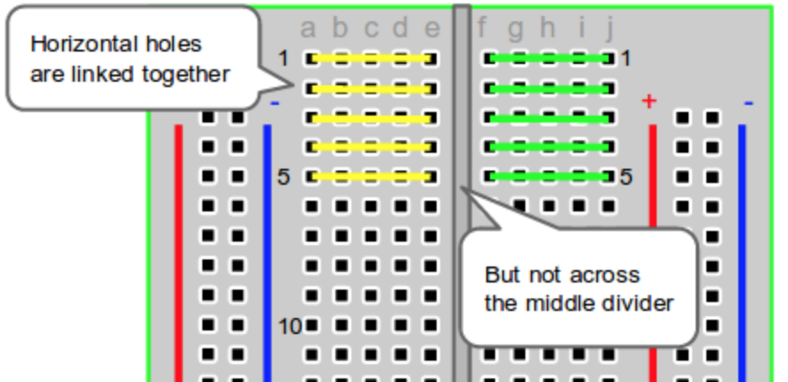
Breadboard Basics

Slide 3
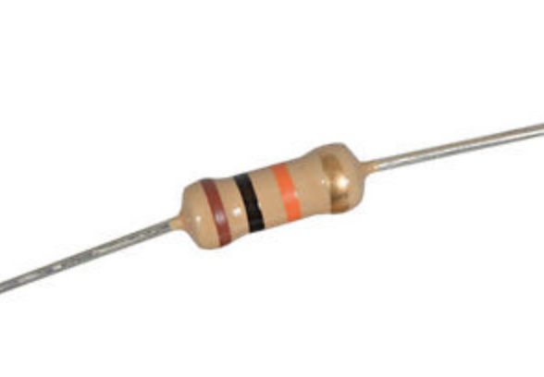
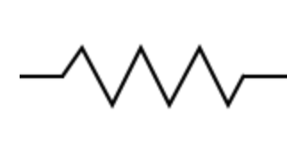
Resistor
Limits current
Passive component
Measured in Ohms (Ω)
Ohm’s Law:
I = V / R
(Current = voltage/resistance)

Slide 4
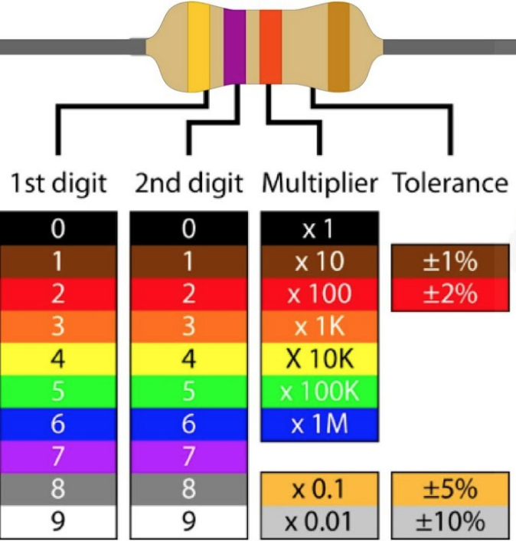
10kΩ:
Brown-black-orange
1kΩ:
Brown-black-red

Slide 5
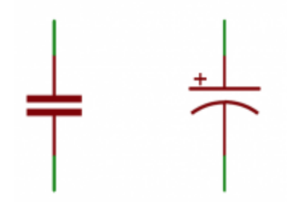
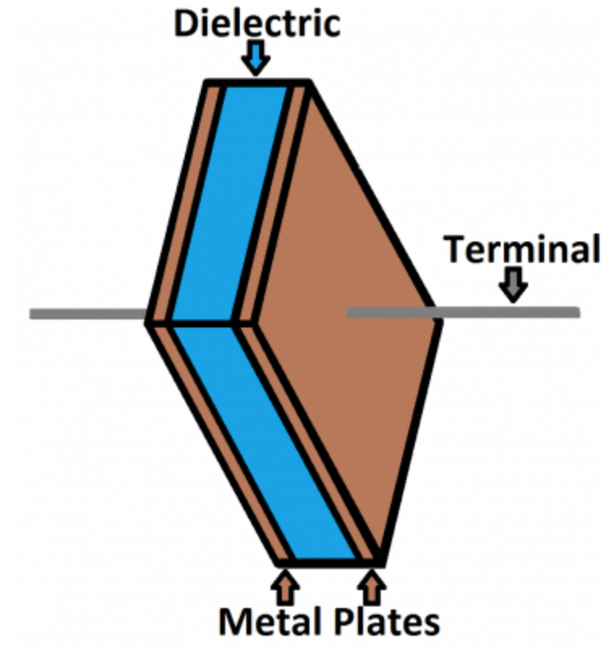
Capacitor
Stores energy
Passive
Measured in Farad (F)
C = Q / V
(Capacitance =
Electric charge / voltage)

Slide 6
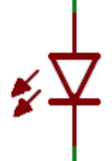
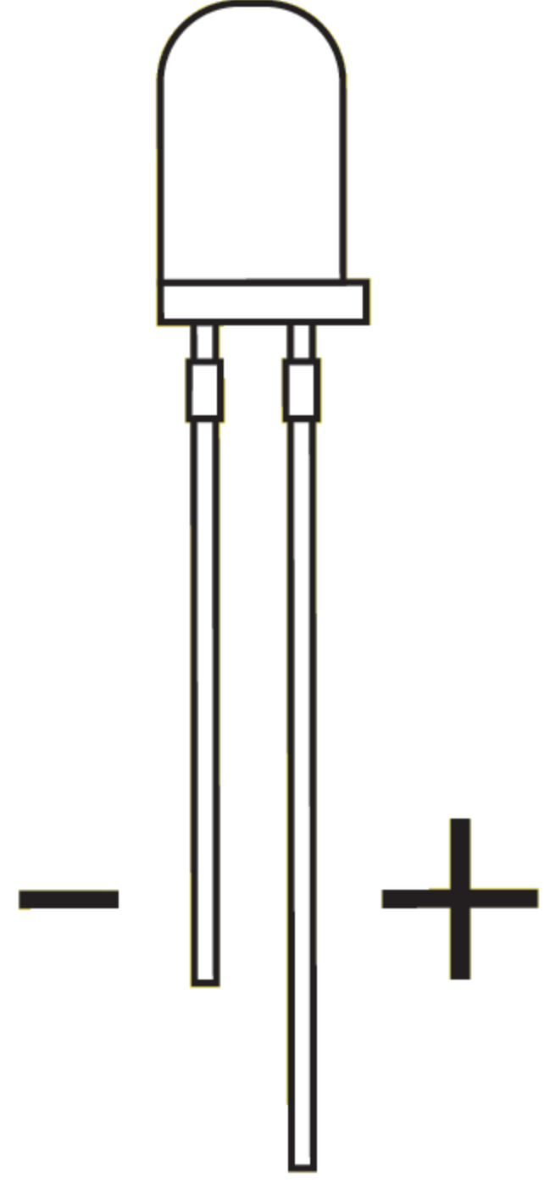
Light-Emitting Diode (LED)
Controls the direction of current flow
Creates light by electroluminescence in a semiconductor material
polarity!
Notes:
Longer leg-->anode
Shorter leg-->cathode

Slide 7
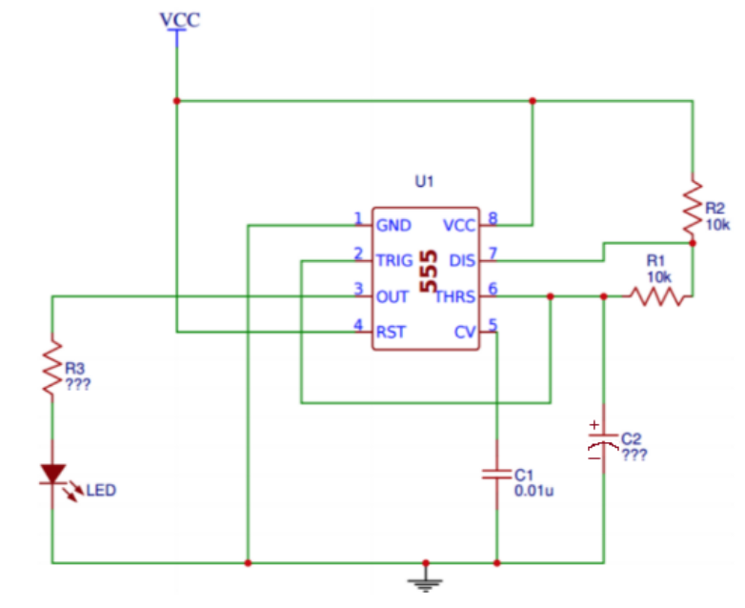
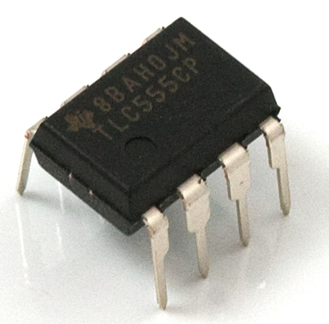
555 Timer
Pin 1: Ground (GND)
Pin 8: Power (VCC)
Pin 4: Reset (RST)
Restarts the timer when LOW
(notice how it will never be LOW here)
Pin 2: Trigger (TRIG)
Controls output, will always be opposite of pin 3
Connects to pin 6
Pin 3: Digital Output (OUT)
Only HIGH or LOW, duration controlled by rest of circuit
Pin 5: Control Voltage (CV)
Connects to GND with small CAP (C1) to remove fluctuations in supply voltage
Pin 6: Threshold (THRS)
Monitors voltage across CAP (C2)
Pin 7: Discharge (DIS)
Starts to discharge the CAP (C2) when it is fully charged

Slide 8
LED Blinker
Circuit
Notes:
0.1uF, not 0.01

Slide 9
Let’s make it blink!

Slide 10
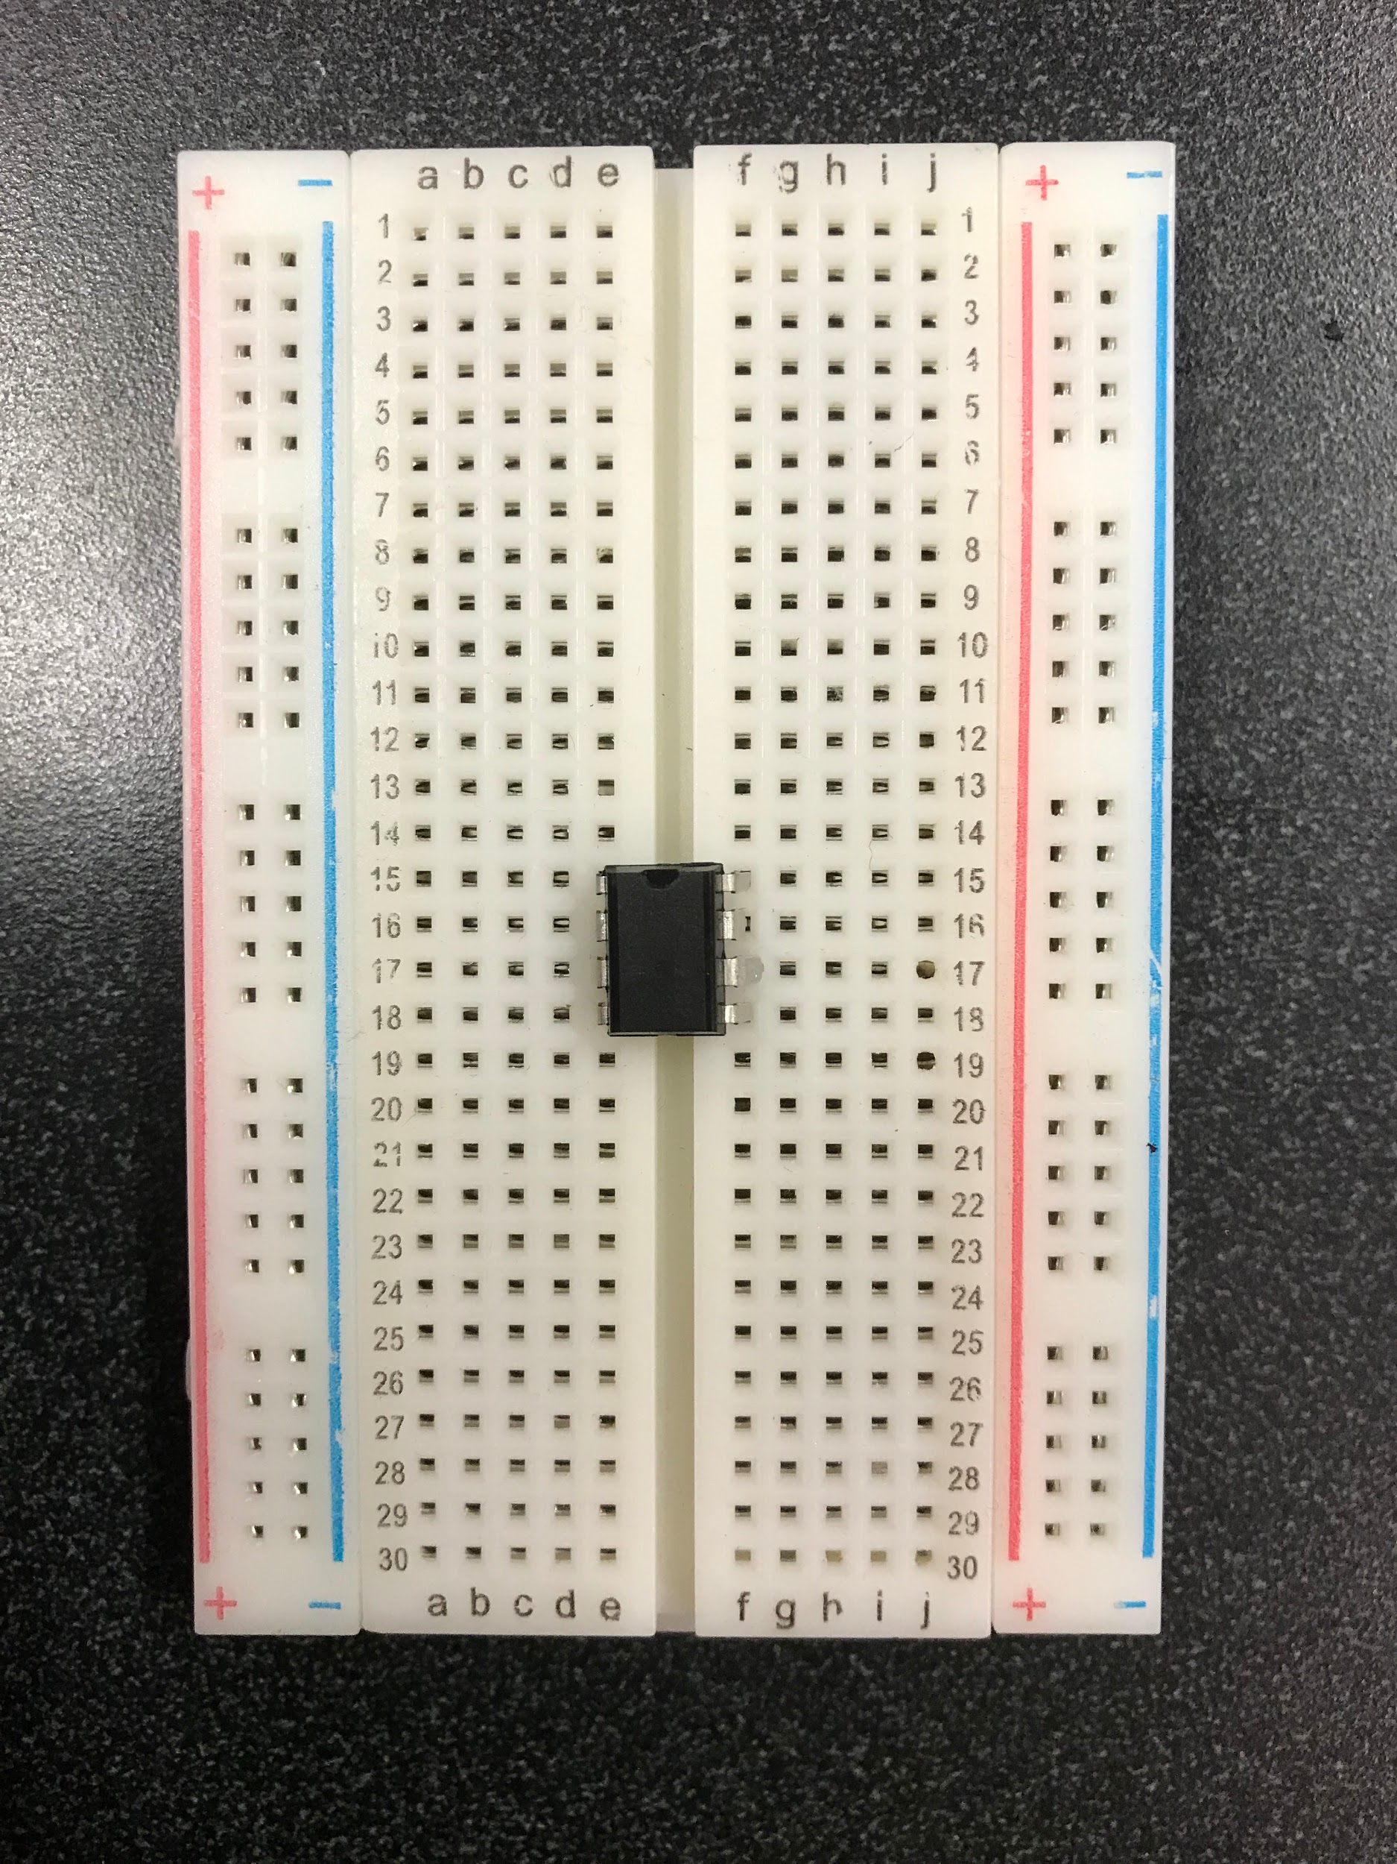

Slide 11
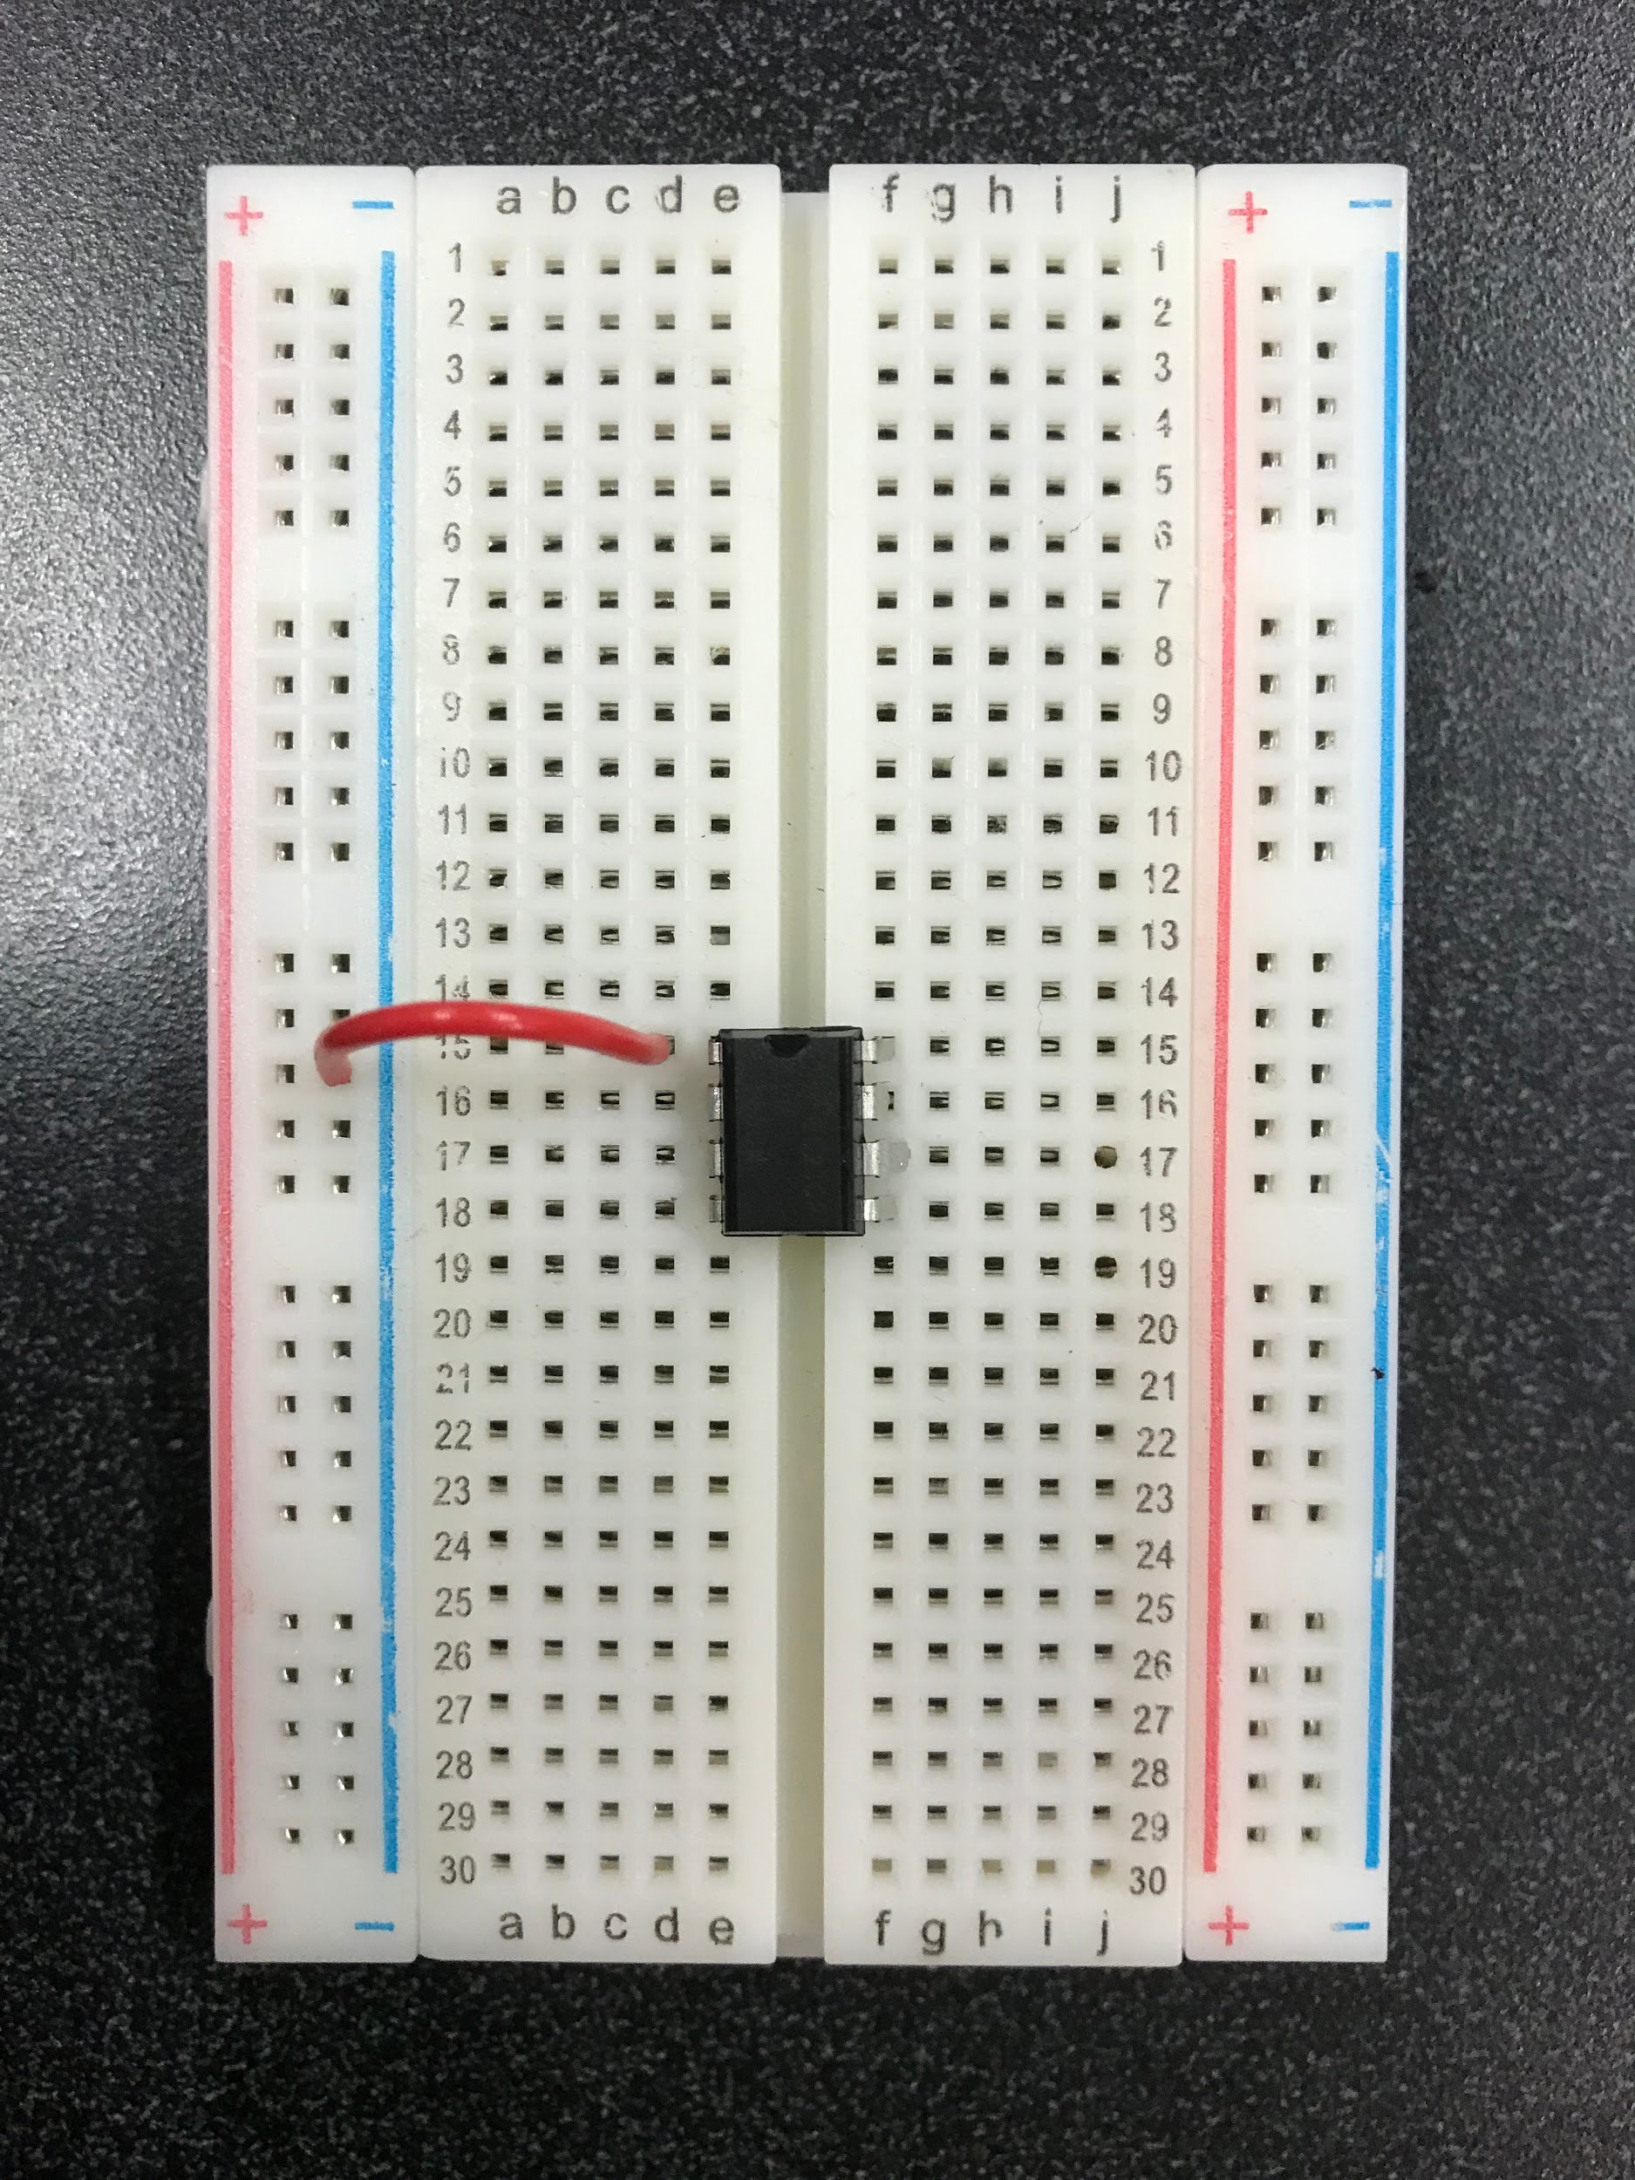

Slide 12
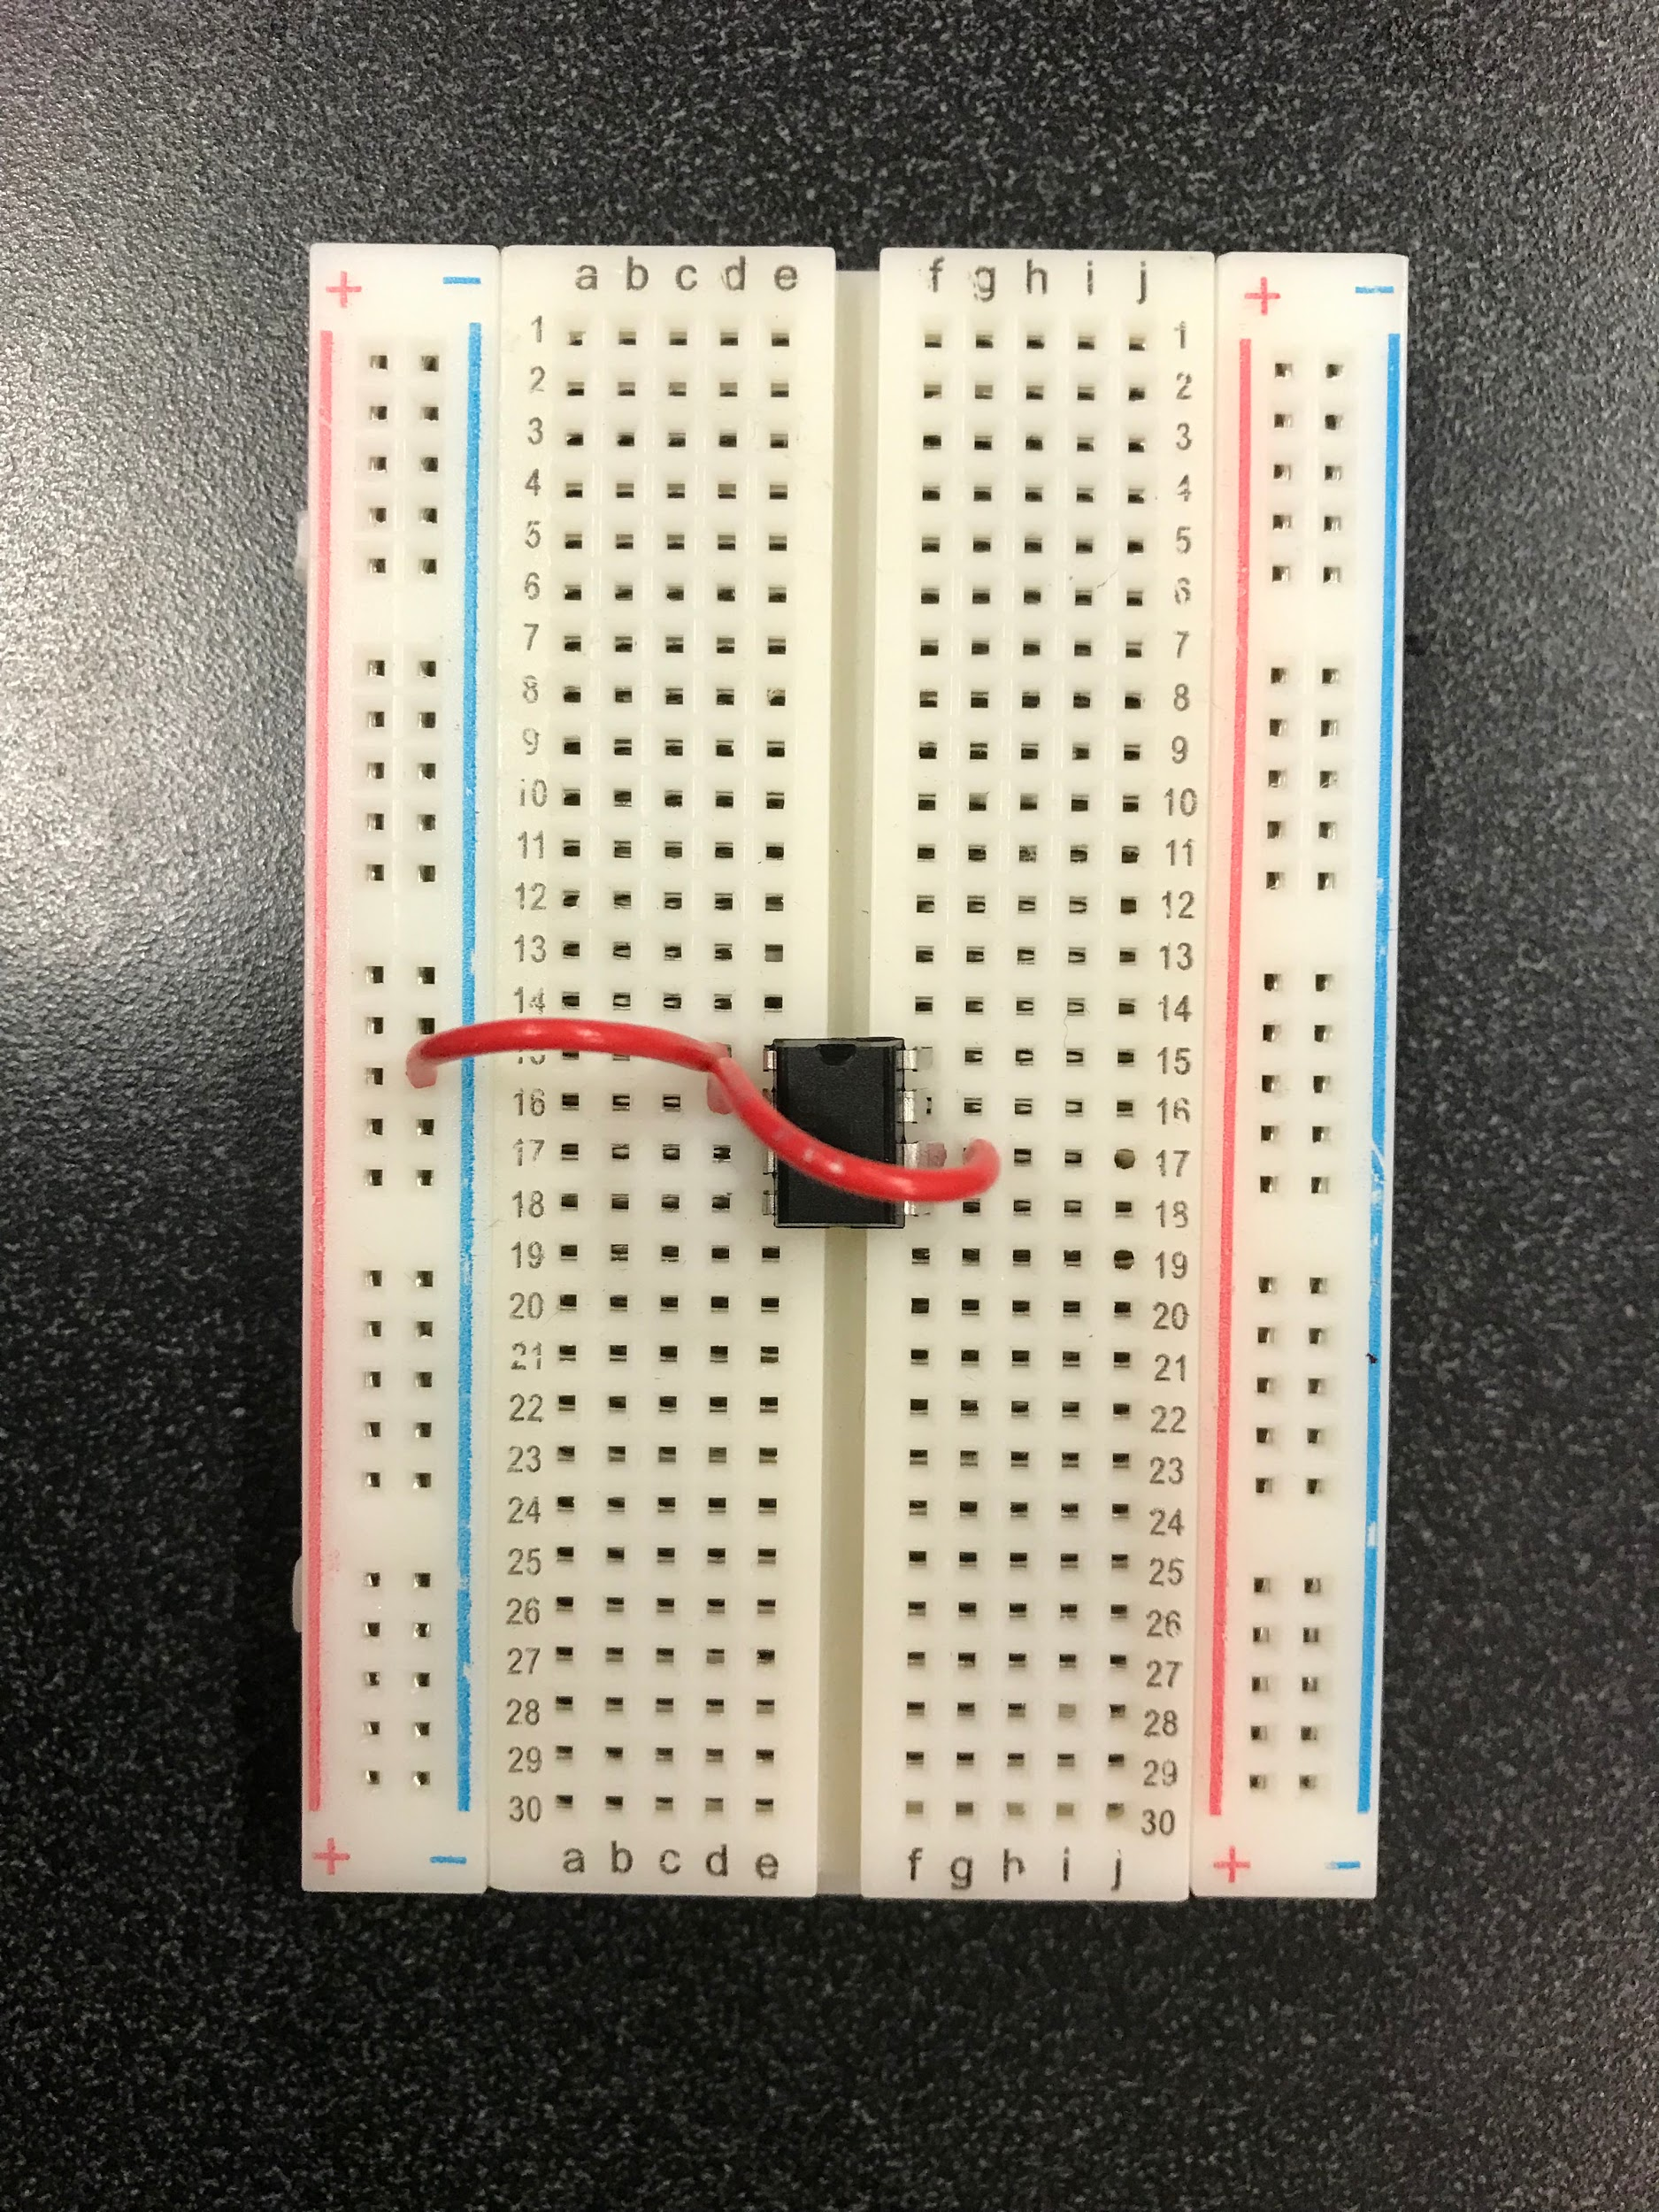

Slide 13
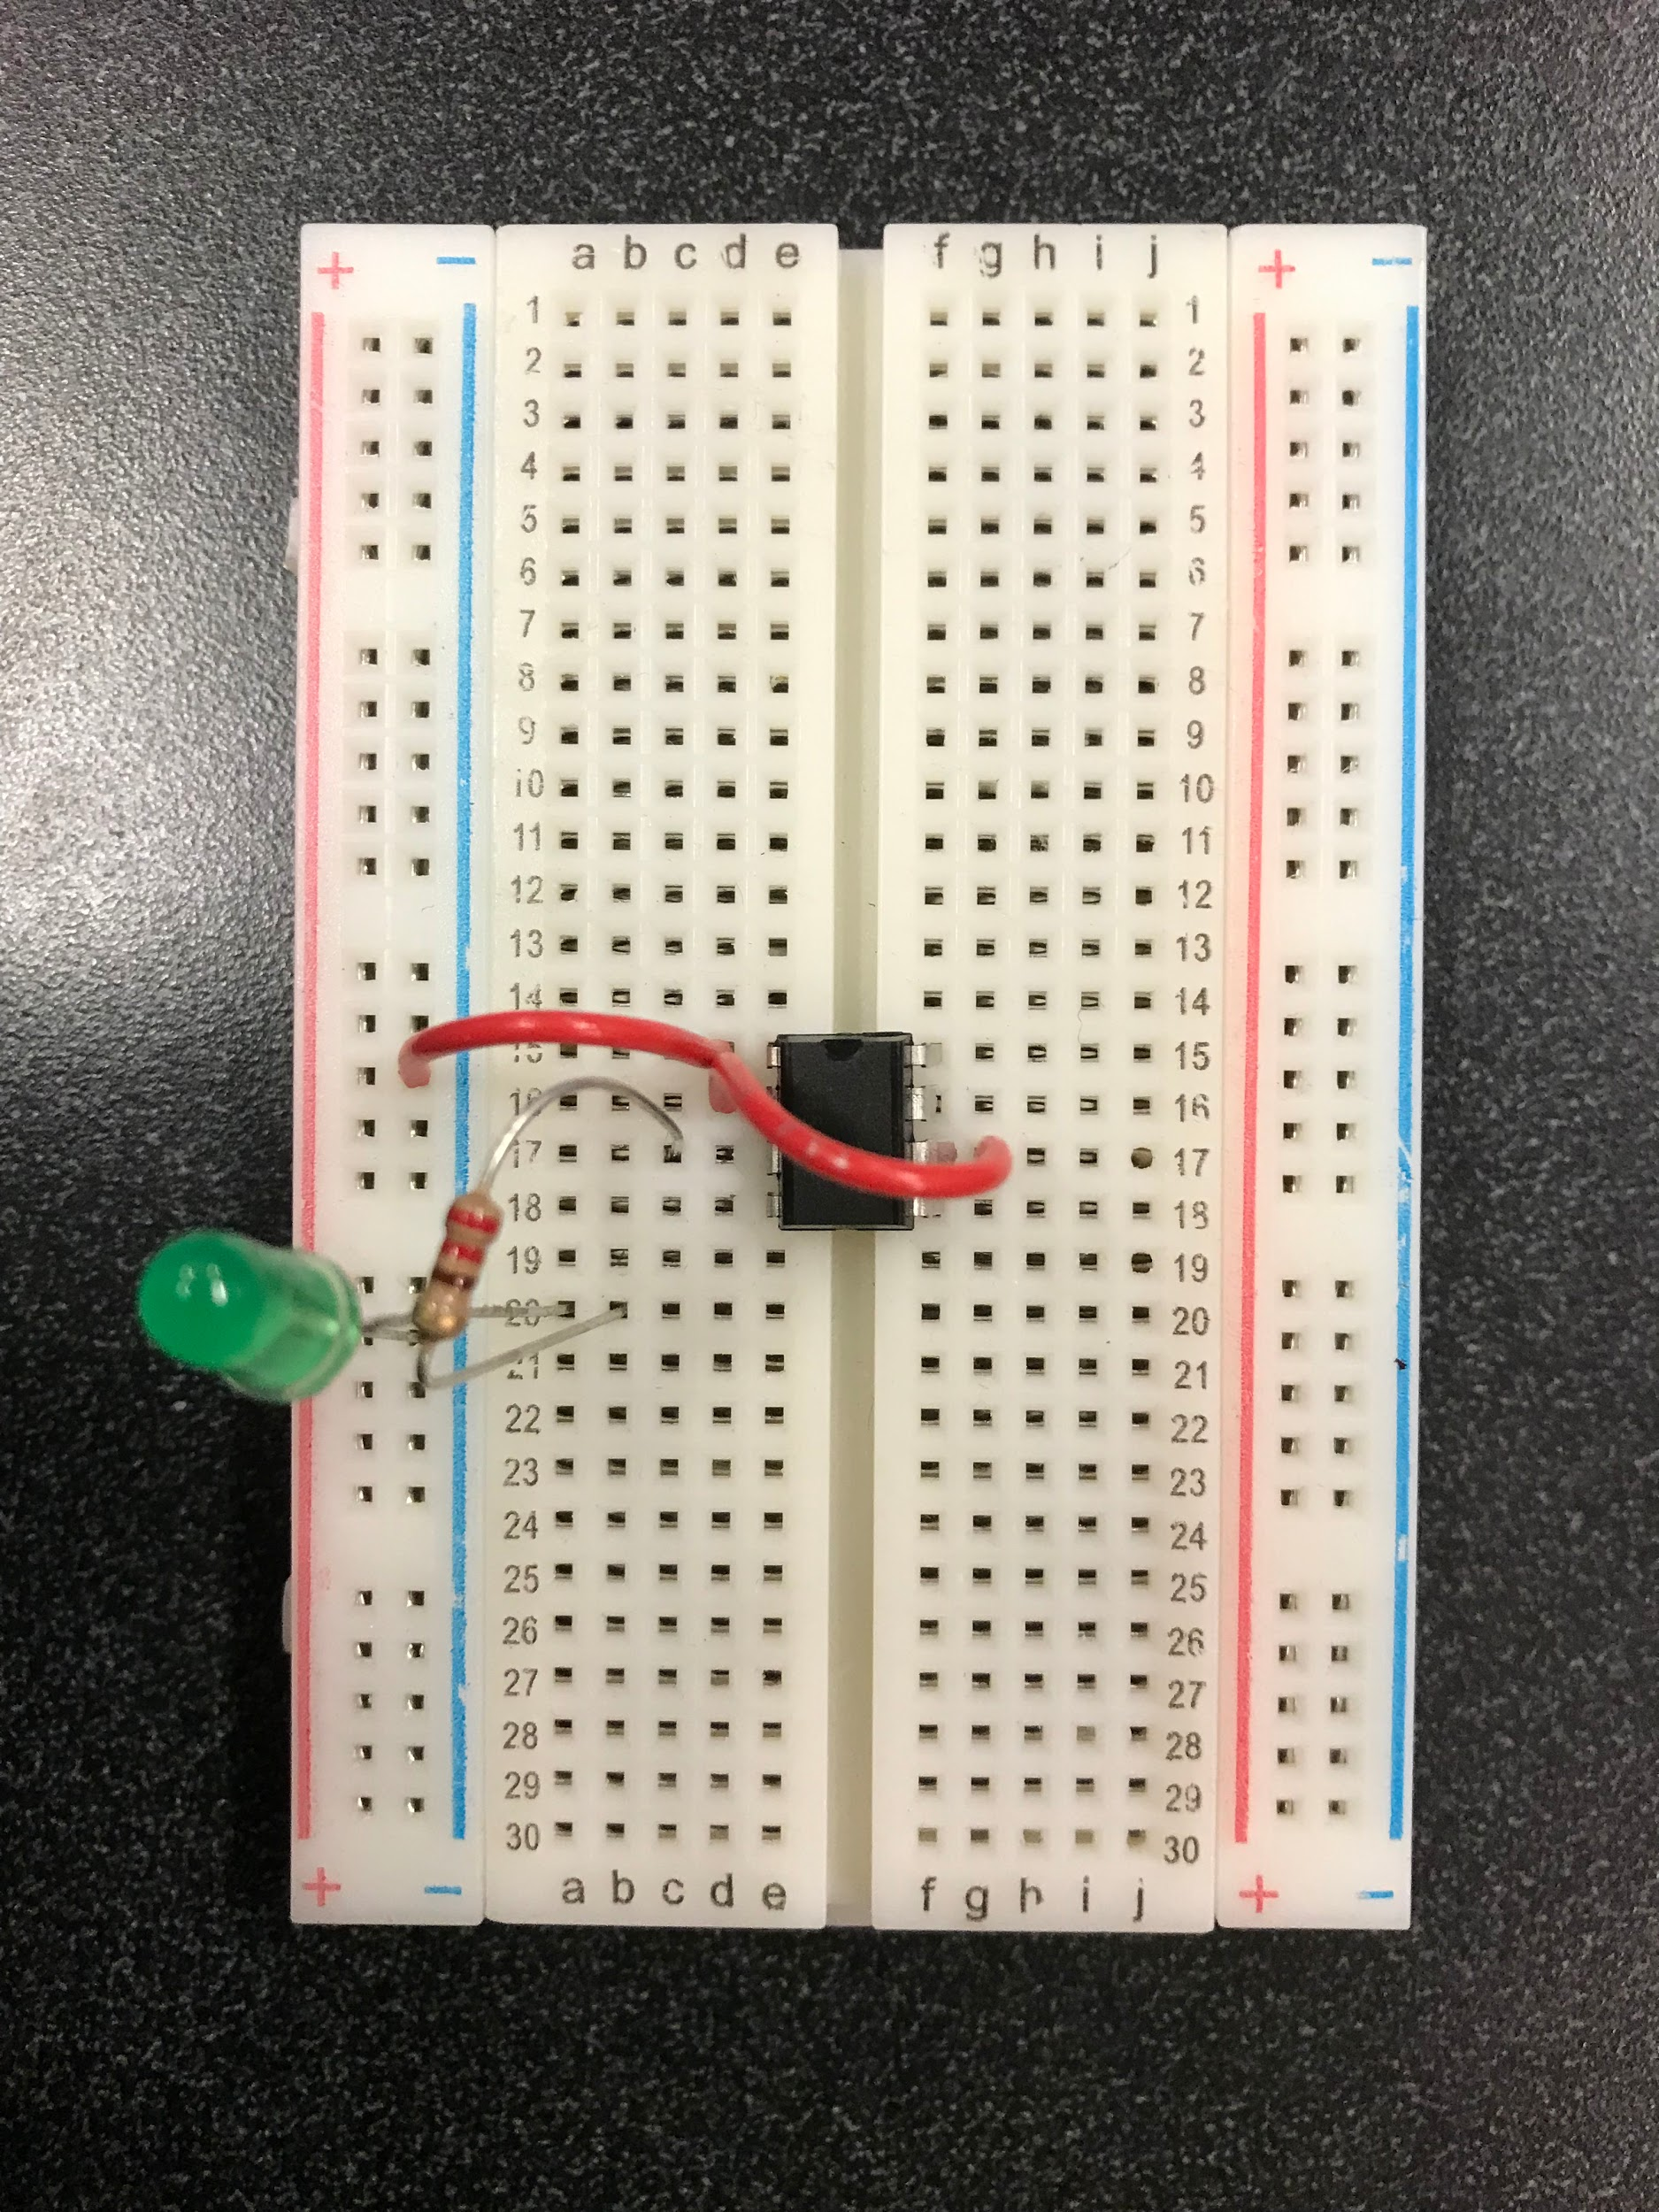

Slide 14
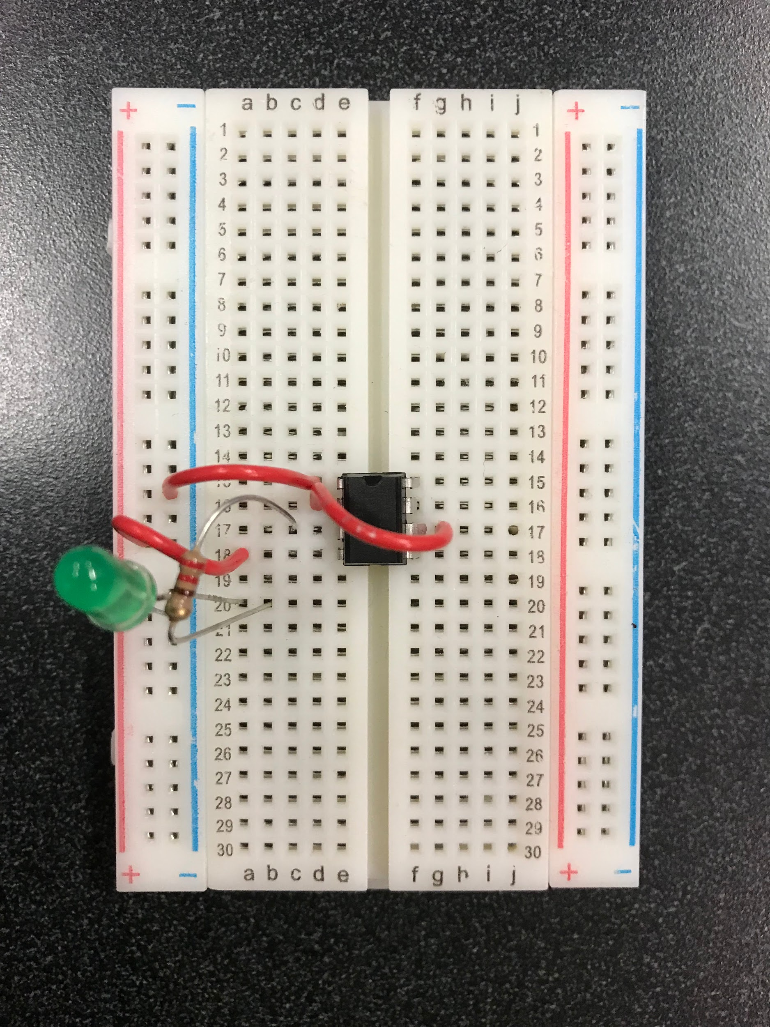

Slide 15
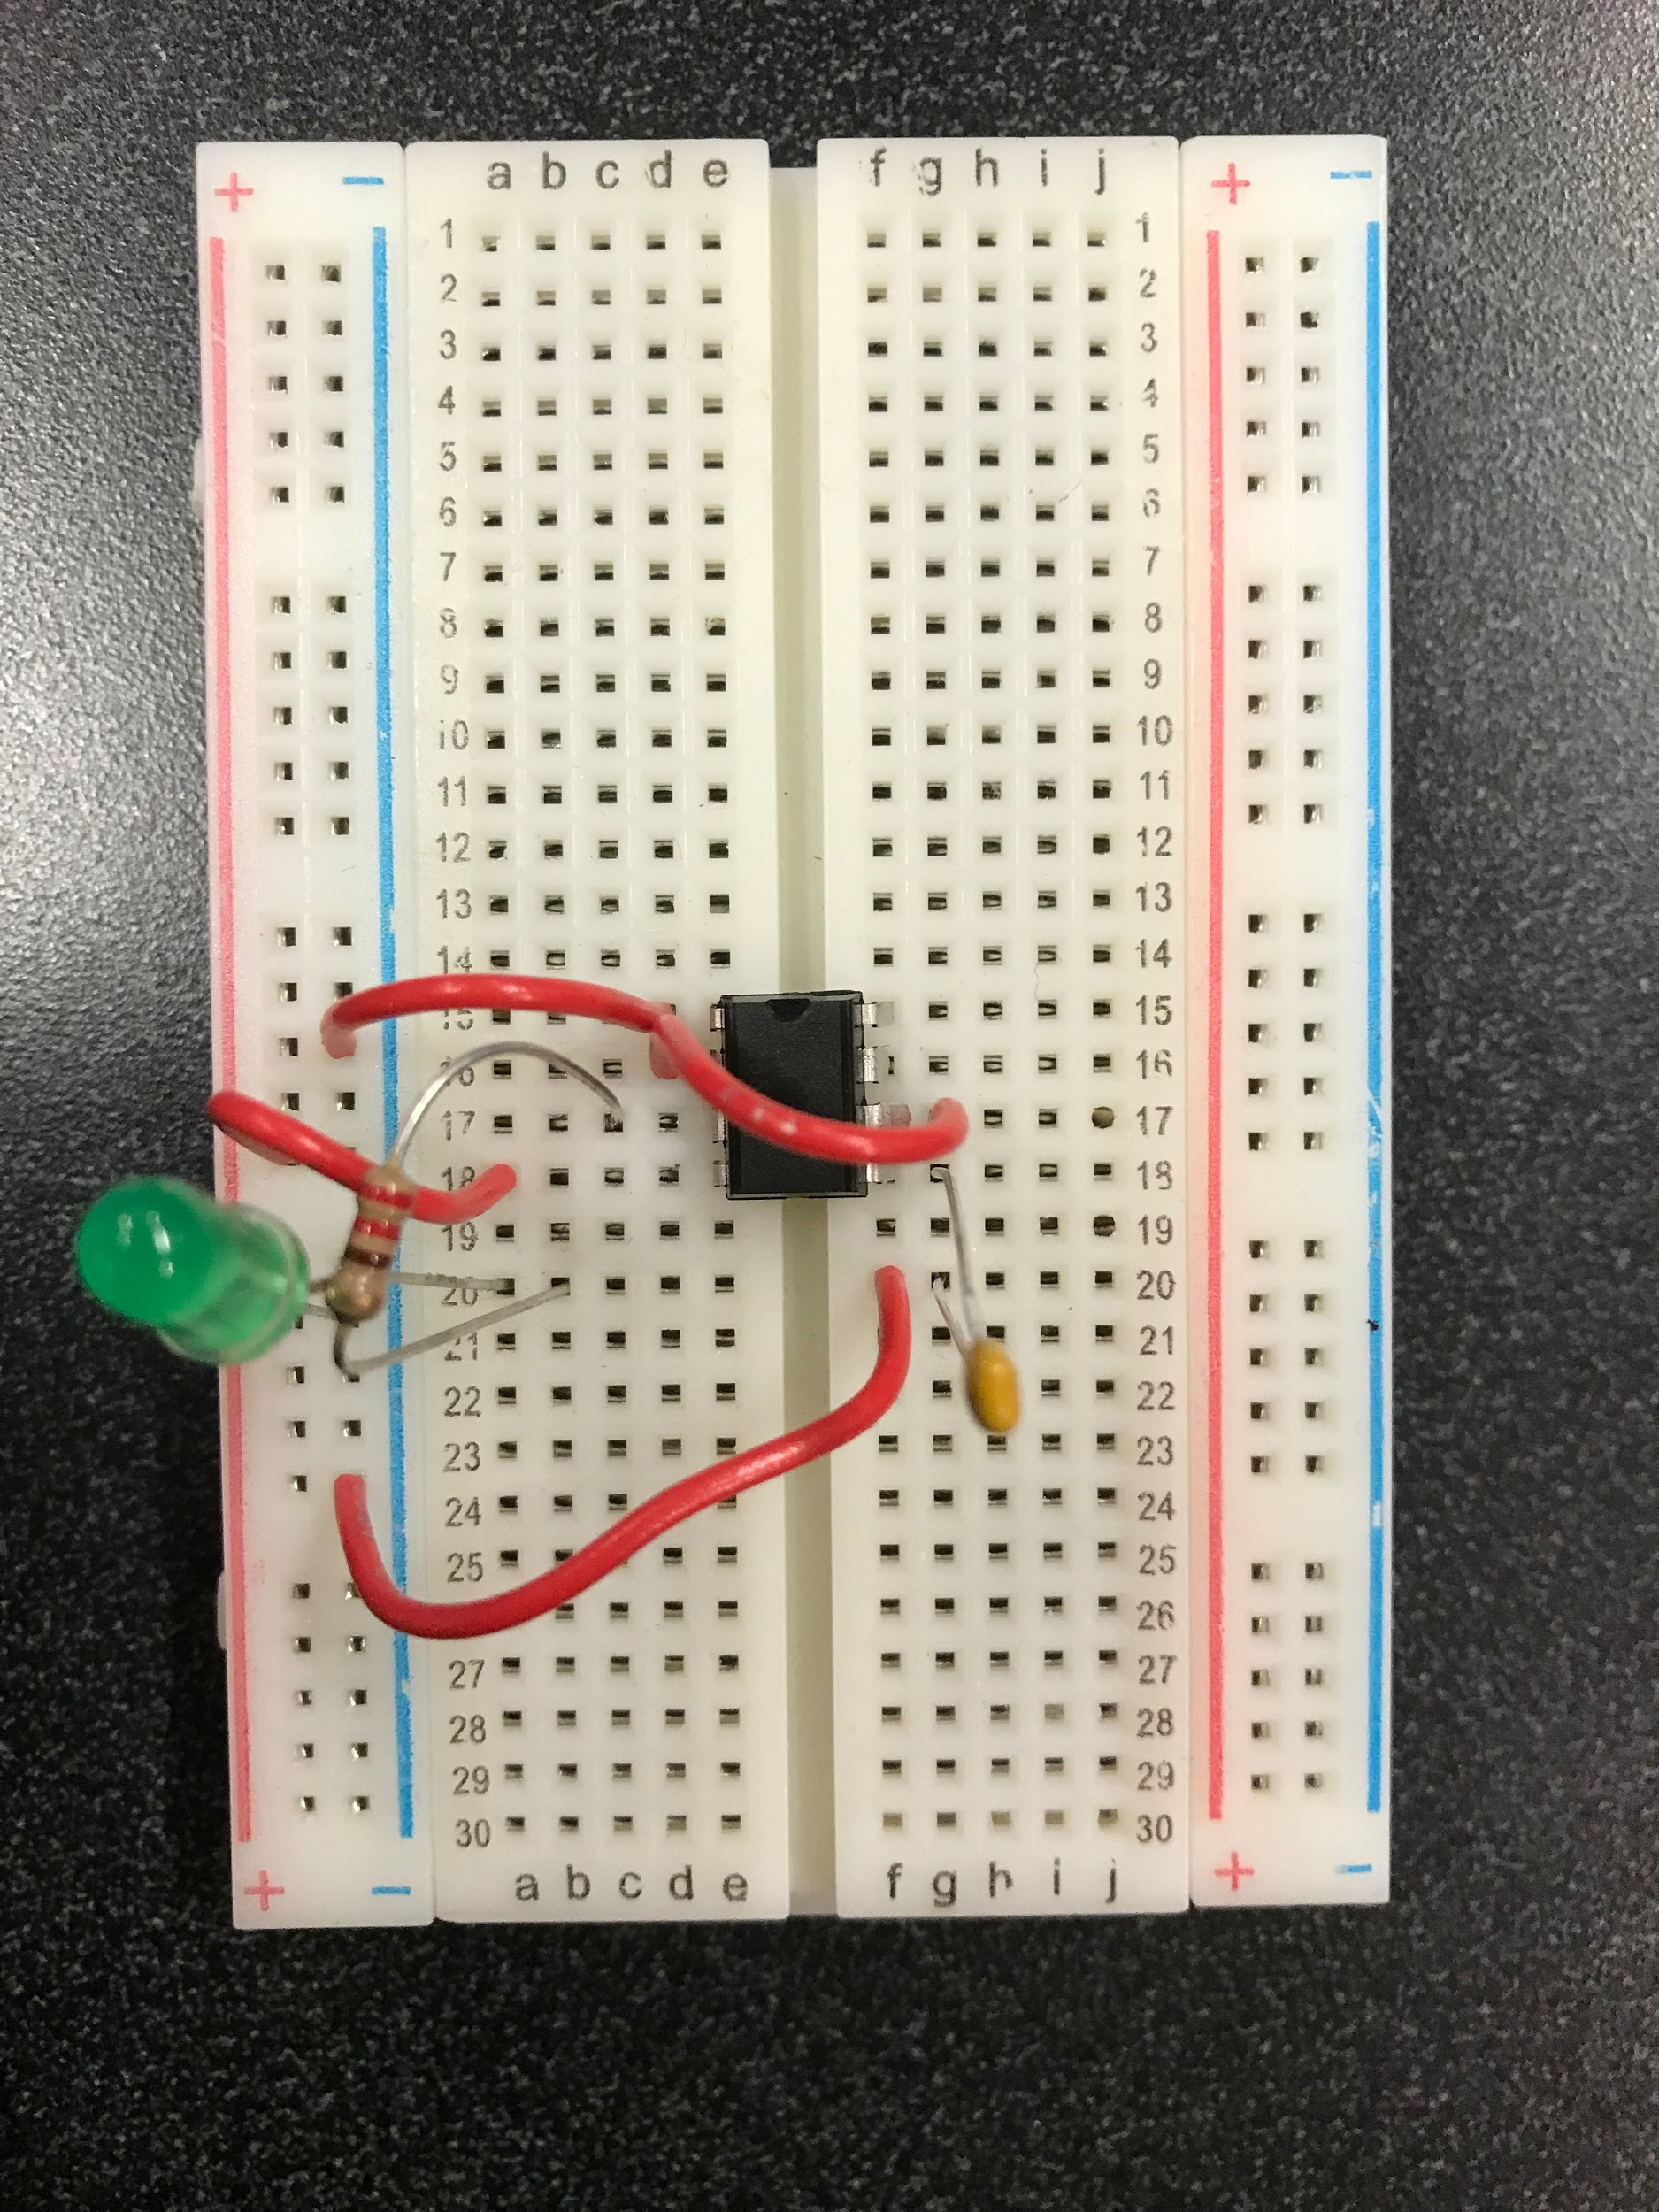

Slide 16
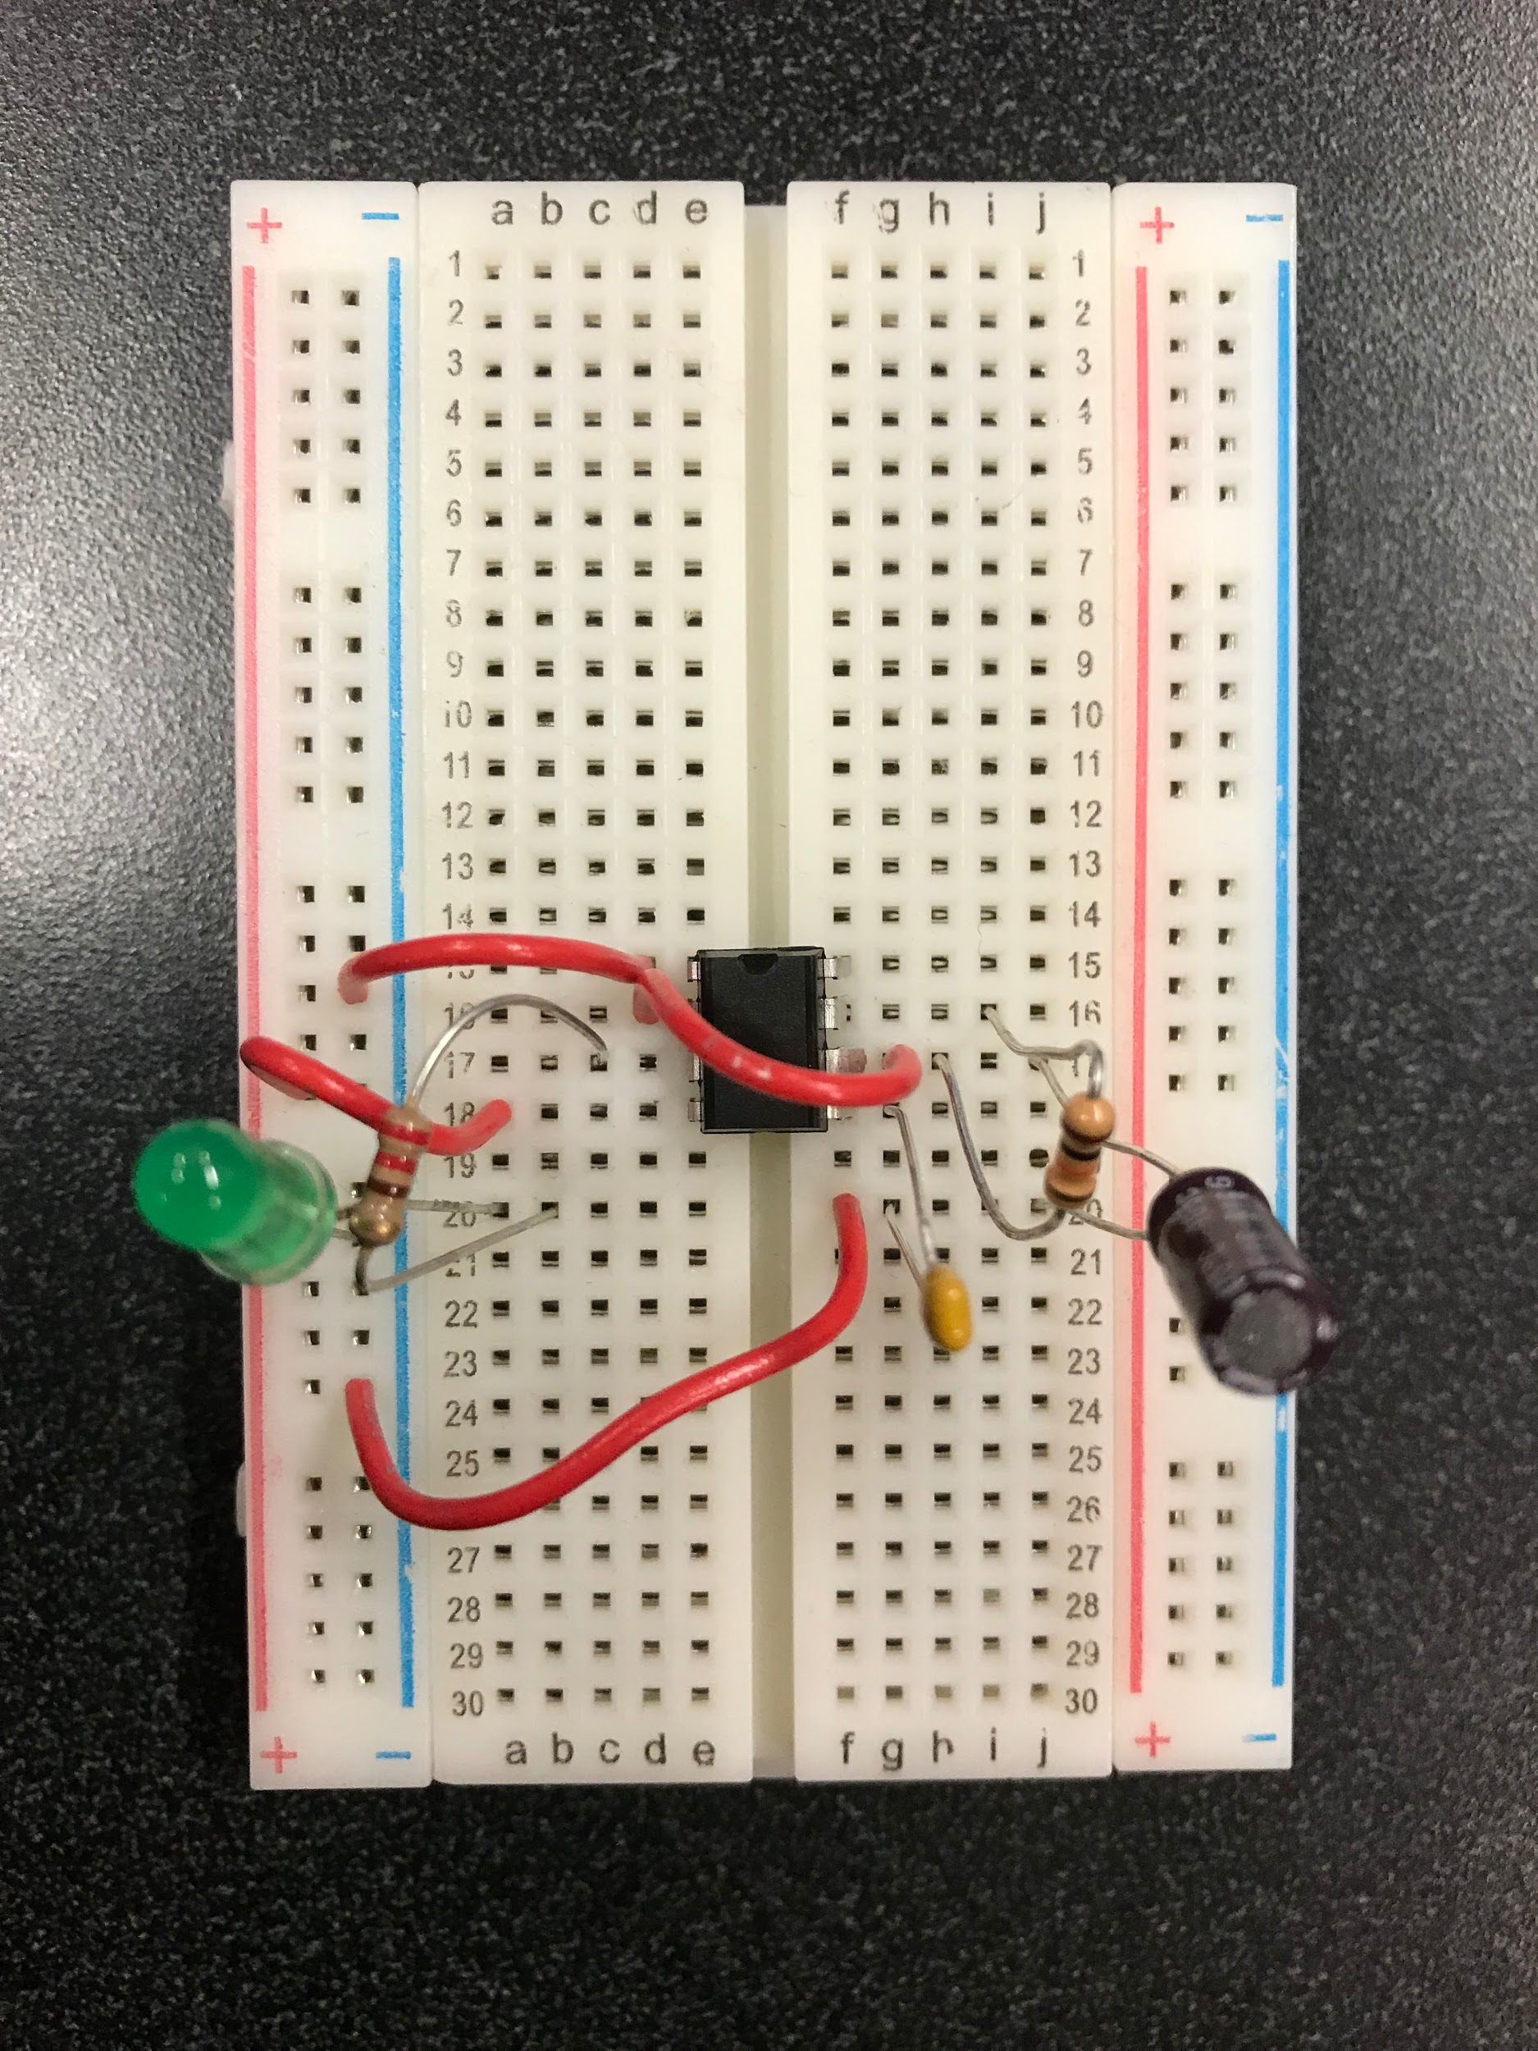

Slide 17
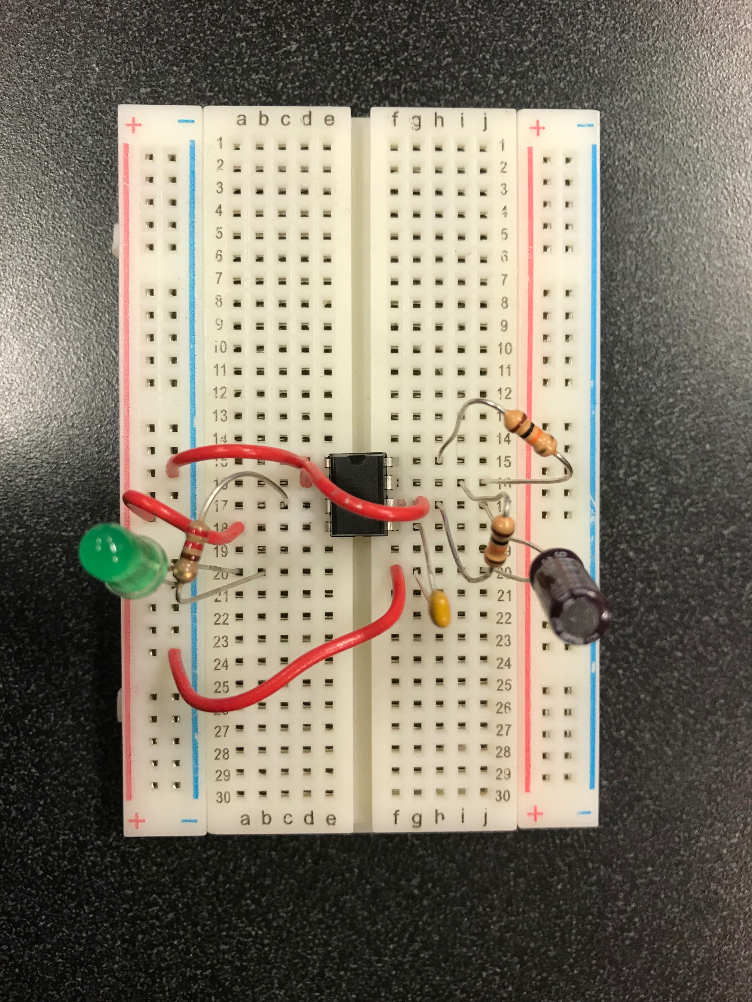

Slide 18
